Slide 1
Percentage
Lecture: 7

Slide 2
Concept to discuss
Successive Percentage Change.
Problem based on Elections.
Population change & percentage error.

Slide 3
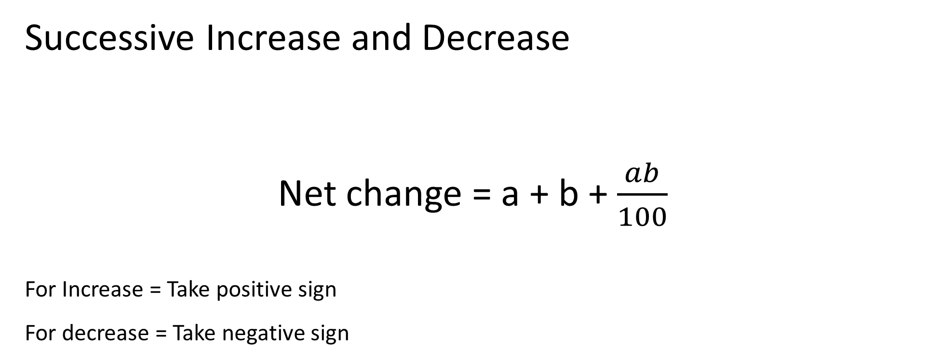

Slide 4
Question : Price of petrol first increased by 20% and then it is decreased by 10% . Find the net change in the price.
8 % increase
2 % decrease
10 % increase
8 % decrease

Slide 5
Question : Demand of a car went down by 25 % in 2016 and 20 % in 2017. What is net % decrease in demand?
45 %
40 %
50 %
60 %

Slide 6
Question : If the length of a rectangle is increased by 20 % and width is decreased by 30% then find the resultant change in area.
16 %
20 %
24 %
28 %

Slide 7
Question : A number is first increased by 15% and then decreased by 20%. The number so obtained is 64 less than the original number. What is the original number?
600
750
800
860

Slide 8
Question :If the price of petrol is raised by 20% then the percentage by which a car owner must reduce his consumption so that there is no change in expenditure.
16.66 %
18 %
15 %
25 %

Slide 9
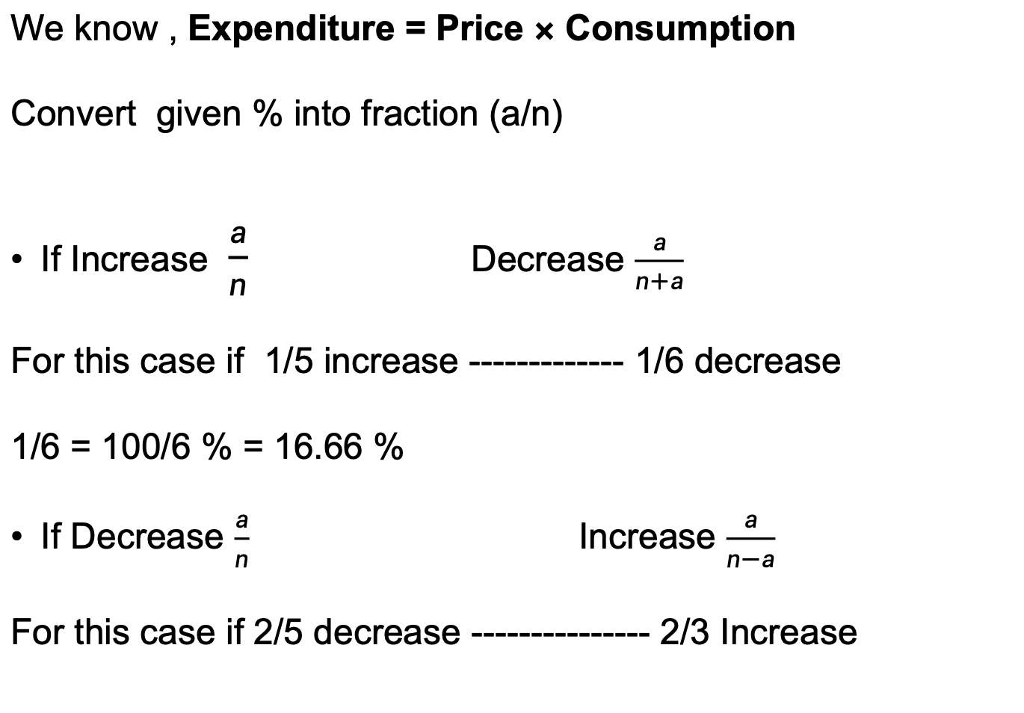

Slide 10
Question :If the price of sugar is decreased by 12.5% then the percentage by which one household must increase his consumption so that there is no change in expenditure.
10 %
8 %
14.28 %
12.5 %

Slide 11
Question: If the price of sugar is increased by 25% then by how much percentage consumption should be reduced so that the expenditure will increase by only 5%
(a) 25%
(b) 15%
(c) 16%
(d) 20%

Slide 12
Question :If the price of sugar is reduced by 20% due to which a person can buy 2kg more sugar for Rs. 200. Find the original price of sugar per kg.
Rs. 25 per Kg
Rs. 20 per Kg
Rs. 22 per Kg
Rs. 16 per Kg

Slide 13
Problem based on Elections

Slide 14
Question: In an Election between two candidates one got 65% of the votes and won by 300 votes. Find total no. of votes.
(a) 1200
(b) 1500
(c) 1800
(d) 1000

Slide 15
Question : In a election of 2 candidate the candidate who gets 40% of the total votes rejected by 80 votes. Find total number of votes.
450
400
500
600

Slide 16
Question : In a election of 2 candidate 12 % of the voters did not cast their votes. The winner by getting 45% of the total votes, defeated his rival by 2000 votes. Find the total number of voters.
25000
50000
80000
100000

Slide 17
Question: In an Election, 10% persons didn't cast their votes and 10% found to be invalid. The winner got 54% of valid votes and won by 1620 votes. Find total number of votes?
(a) 12500
(b) 17500
(c) 25000
(d) 35000

Slide 18
Problem based on Population

Slide 19
Question : The population of a town is 50,000. It increases by 10% in the first year and 12% in the second year. What will be the population after 2 years.
55000
61600
72700
84600

Slide 20
Question : The current population of a town is 28,000.During the last 2 years the population increased at the rate of 16% and 20% per year. The population 2 years ago was (approximately)
24000
22000
20000
18000

Slide 21
Question: In a town 20% of the population are Hindi readers, 50% of the remaining are English readers and 30% of the remaining are French readers and rest 6300 people are regional language readers. Then find the total population in town.
(a) 20000
(b) 22500
(c) 35000
(d) 15000

Slide 22


